Slide 1


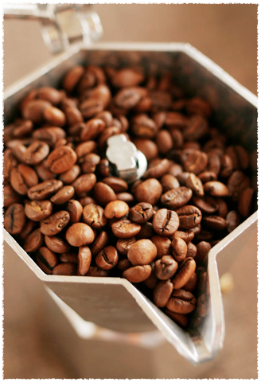

Starbucks
Strategic Analysis

Slide 2


Globalisation Strategy
First location outside North America was opened in Japan in 1996
Entered UK market in 1988
Buying out competitors’ leases
Intentionally operating at a loss
Clustering several locations in a small geographical area

Slide 3
Issues faced
Acceptance of standardised disposable cups in Japan and France
In China people still prefer tea rather than coffee
Culture of serving food with coffee in Italy
In England tackling imitators trying to reduce market share of Starbucks

Slide 4
Current Position
Reaching brand maturity stage in U.S.
Location strategy
    saturated home market
    leading to self cannibalisation
    Closed nearly 900 stores worldwide and eliminated 34,000 jobs
    Hence successful globalisation is much needed

Slide 5
Recommendations
Strategy based upon generating more revenue with lower costs
Push product innovations such as Via instant coffee and consumer products in international market
Foreign Store expansion - business partners who share the cost and risk
Reinvigorating Seattle’s Best Coffee (ignored secondary brand)

Slide 6
Another Strategy

